Slide 1
Water induced Restructuring of Vanadia clusters supported on a-TiO₂ (101) hydration dynamics
K. C. Adamsen et. Al.

Slide 2
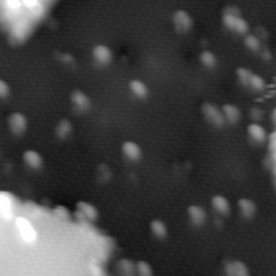
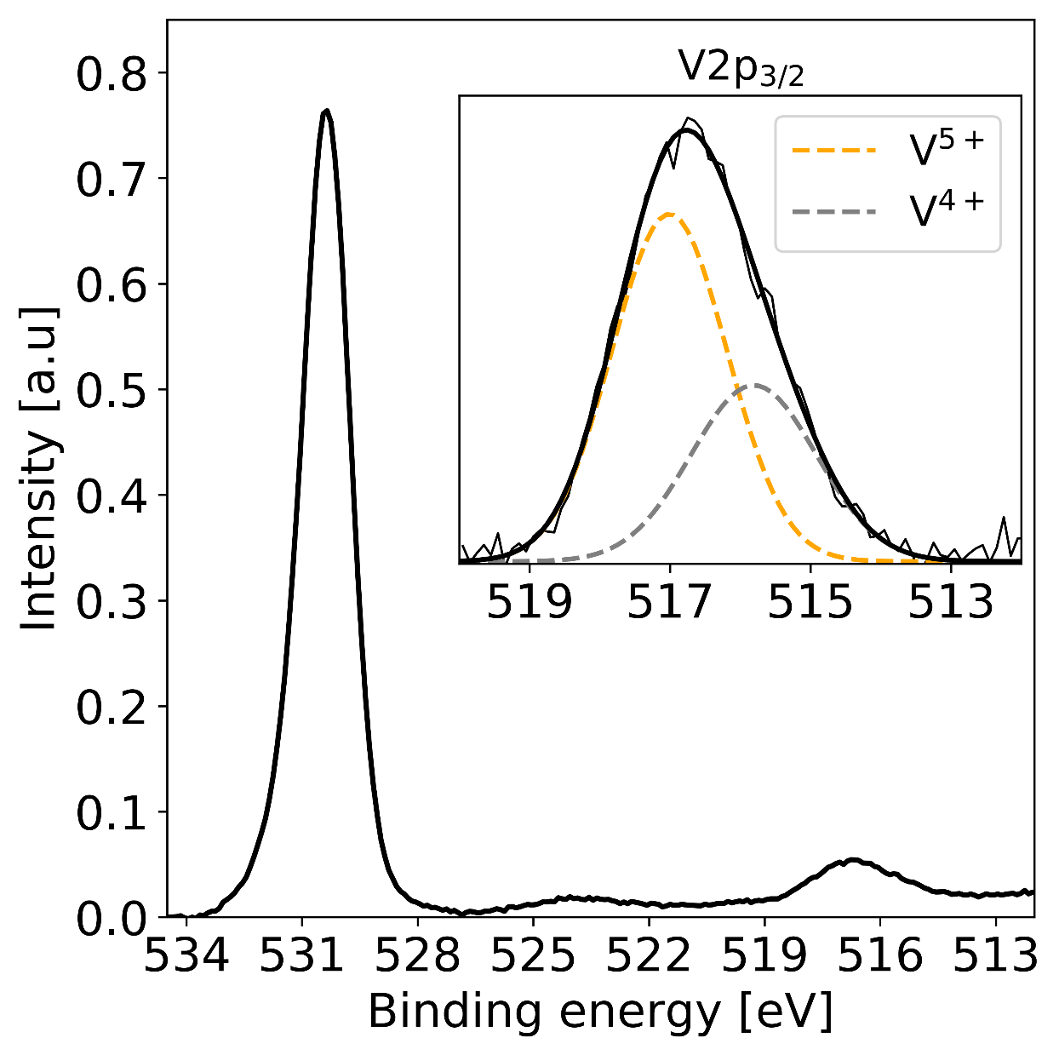
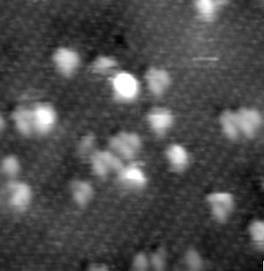
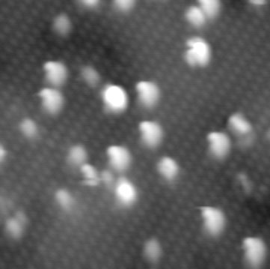
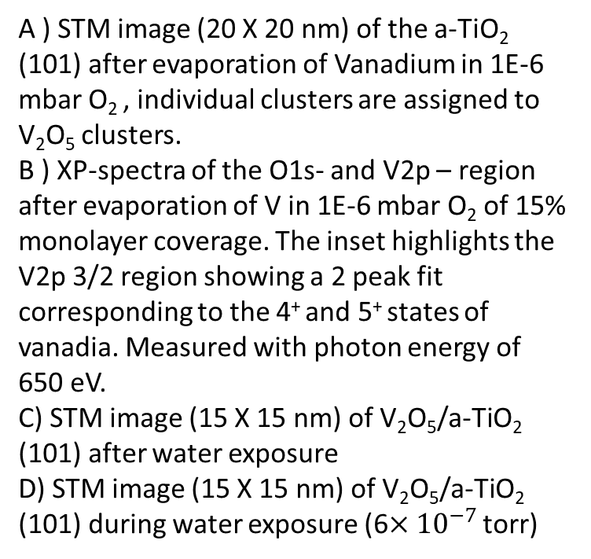
Figure 1, overview
A
B
A ) STM image (20 X 20 nm) of the a-TiO₂ (101) after evaporation of Vanadium in 1E-6 mbar O₂ , individual clusters are assigned to V₂O₅ clusters. B ) XP-spectra of the O1s- and V2p – region after evaporation of V in 1E-6 mbar O₂ of 15% monolayer coverage. The inset highlights the V2p 3/2 region showing a 2 peak fit corresponding to the 4⁺ and 5⁺ states of vanadia. Measured with photon energy of 650 eV. C) STM image (15 X 15 nm) of V₂O₅/a-TiO₂ (101) after water exposure
D) STM image (15 X 15 nm) of V₂O₅/a-TiO₂ (101) during water exposure (6$×{10}^{−7 }$torr)
D
C

Slide 3
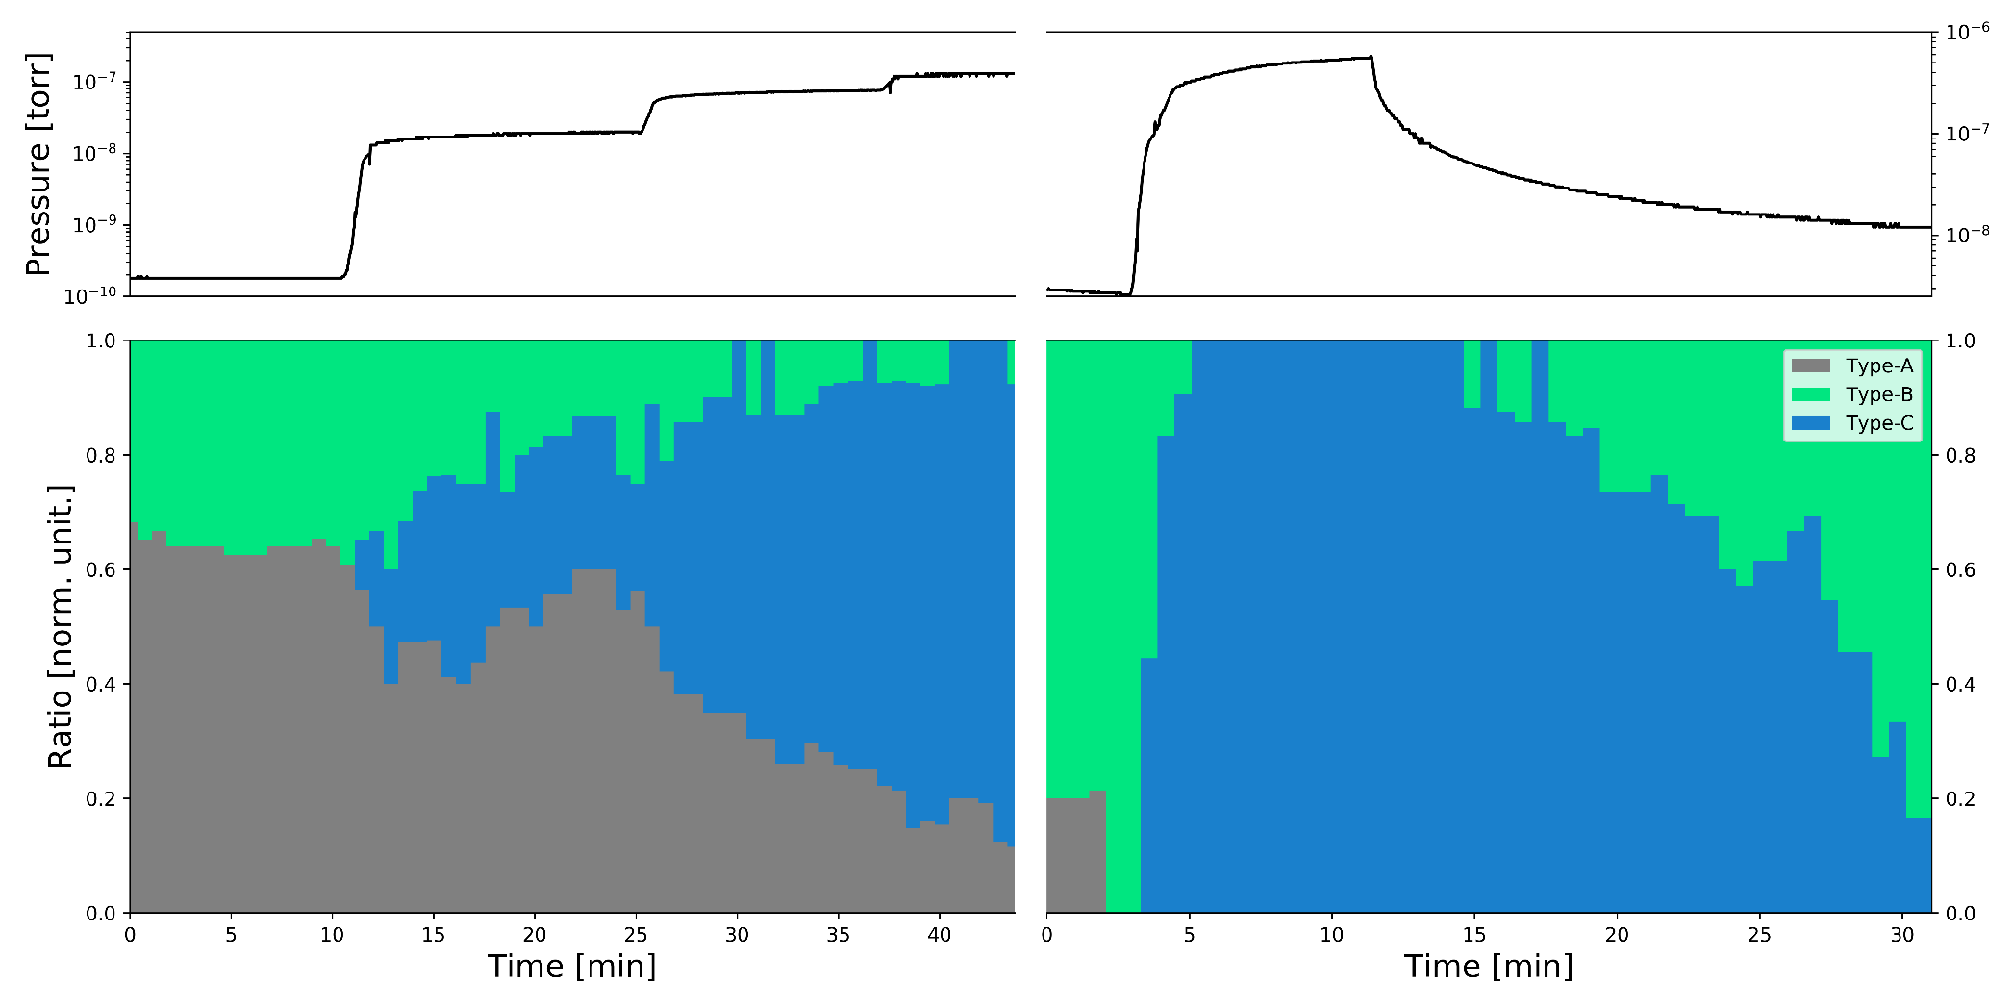
Figure 3, statistics
First exposure
Second exposure
A

Slide 4
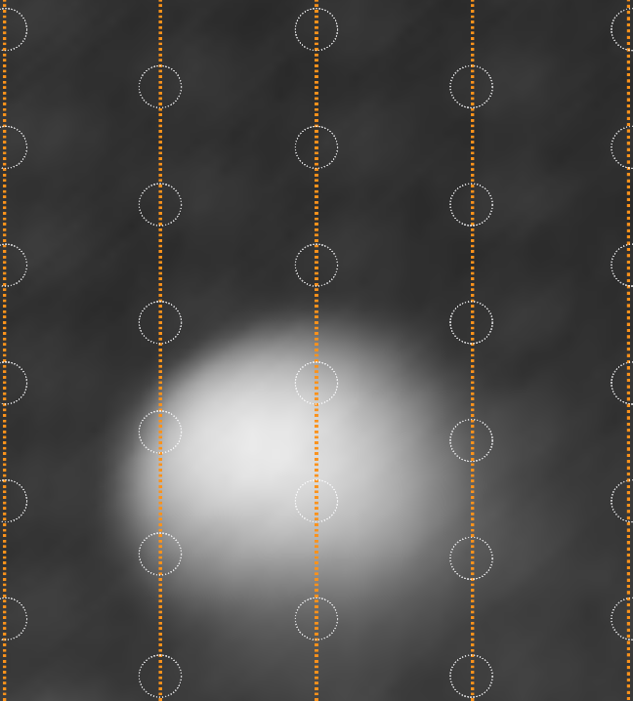
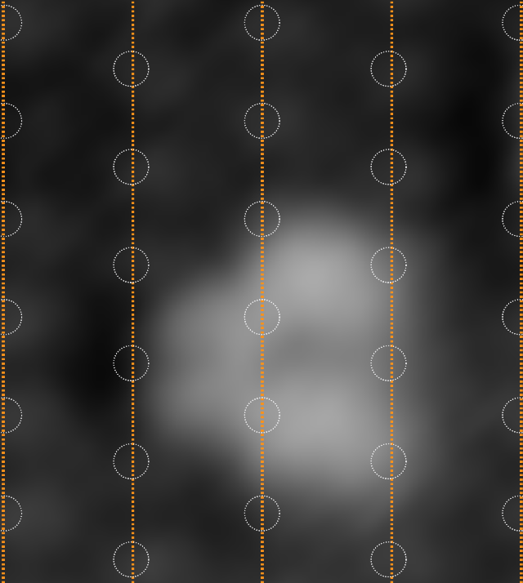
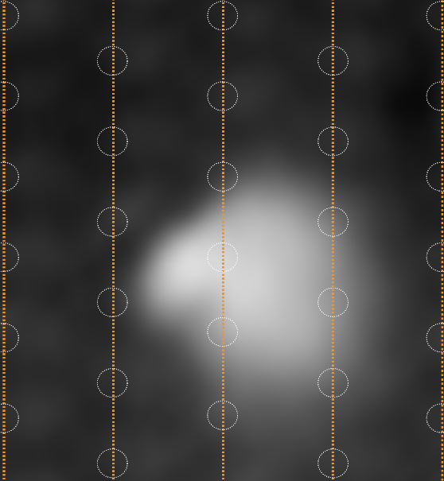
Figure 2, individual structures
2 X VO₃H + H2O /a-TiO₂
Hydrated
2 X VO₃H /a-TiO₂
Dehydrated
V₂O₅/a-TiO₂
Dimer
A
B
C
- H₂O
+ H₂O
+ H₂O

Slide 5
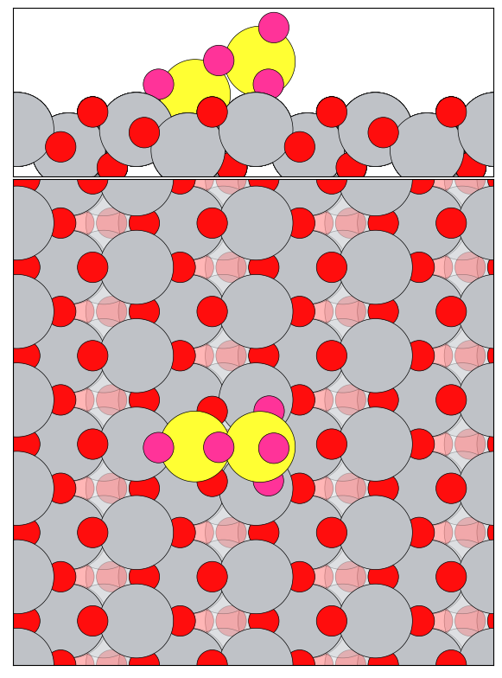
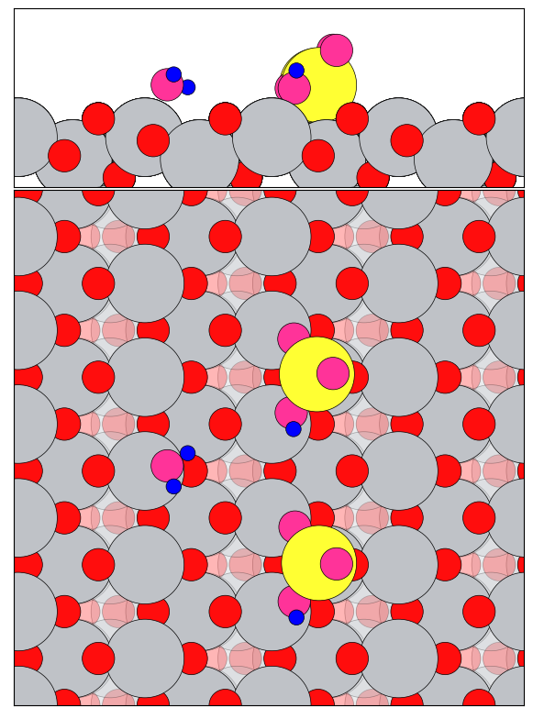
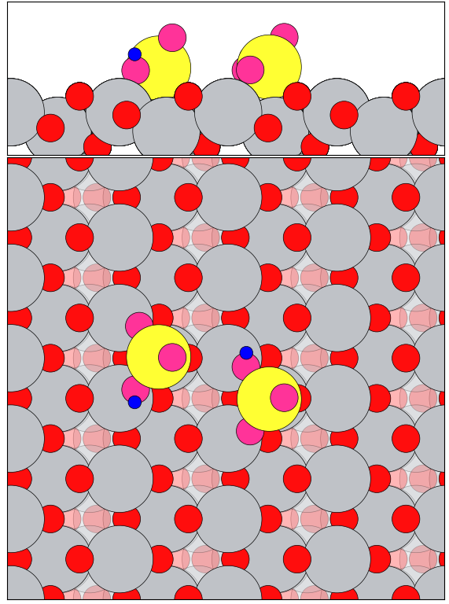
Figures for Paper

Slide 6
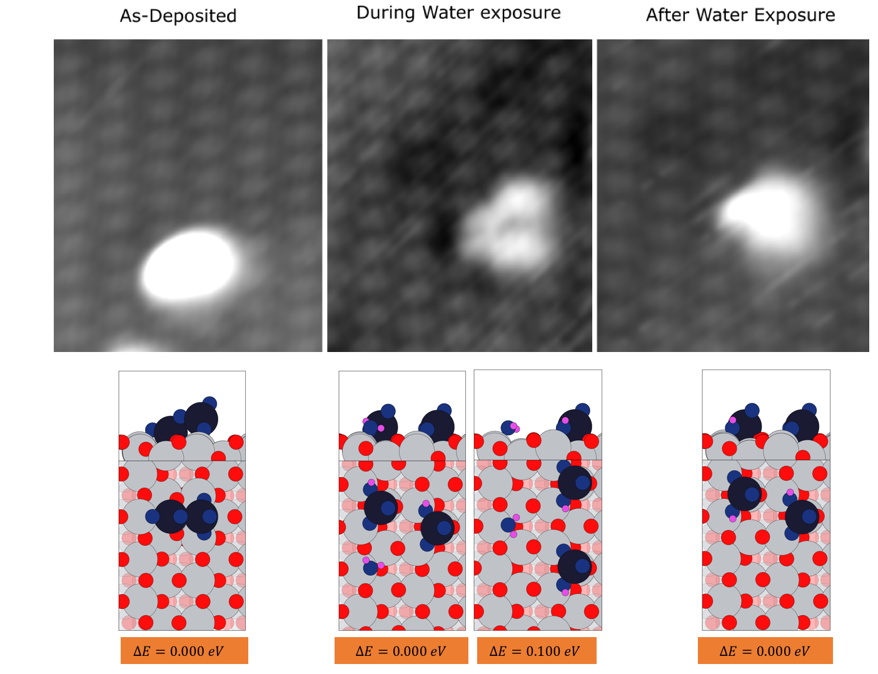
DFT figure
- H₂O
+ 2 x H₂O
+ H₂O

Slide 8
Additional informations and alternative figures

Slide 9
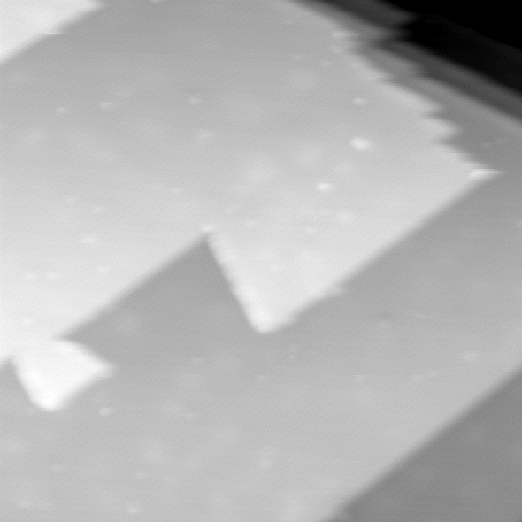
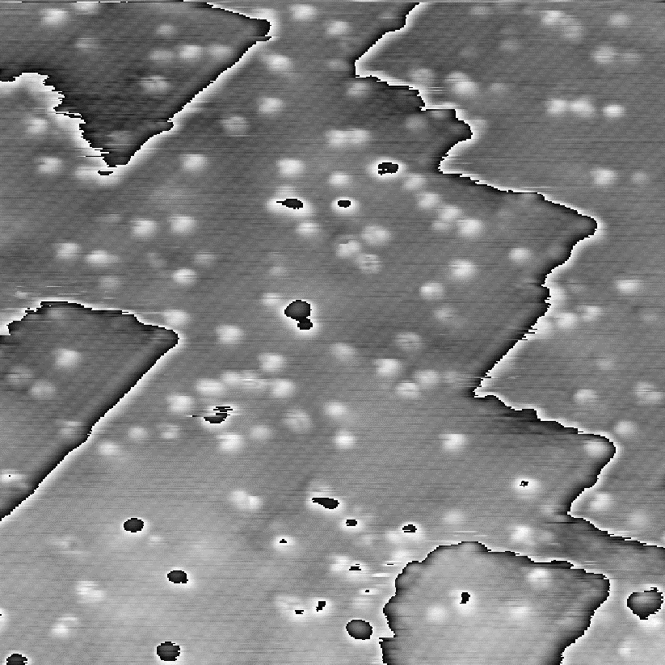
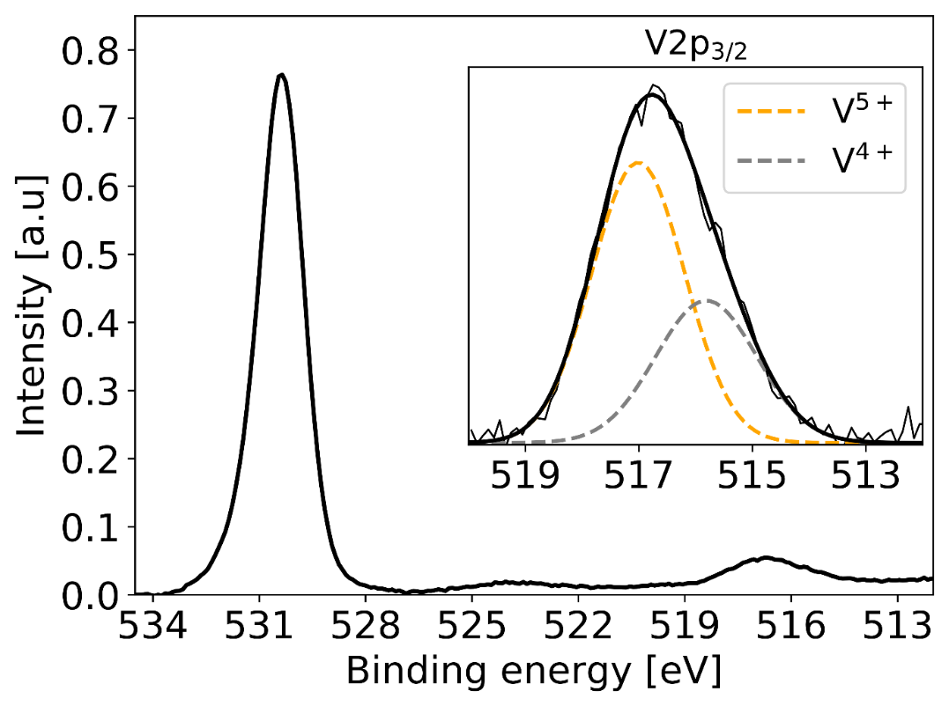
Figure 1, overview
New clean surface image
A
B
C
A ) STM (50 X 50 nm) image of the clean a-TiO₂ (101). B) STM image (50 X 50 nm) of the a-TiO₂ (101) after evaporation of Vanadium in 1E-6 mbar O₂ , individual clusters are assigned to V₂O₅ clusters. C ) XP-spectra of the O1s- and V2p – region after evaporation of V in 1E-6 mbar O₂ of 15% monolayer coverage. The inset highlights the V2p 3/2 region showing a 2 peak fit corresponding to the 4⁺ and 5⁺ states of vanadia.

Slide 10
DFT model , not ready yet

Slide 11
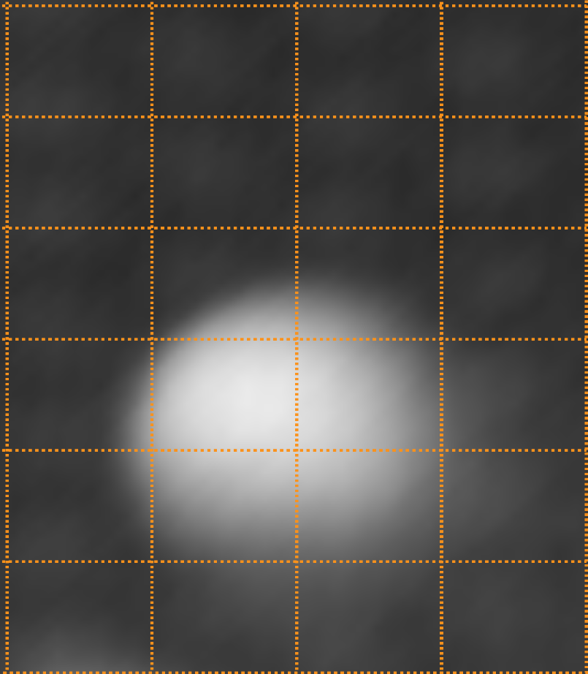
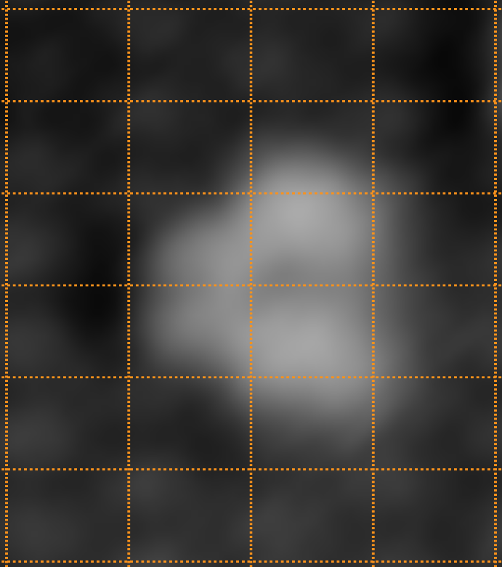
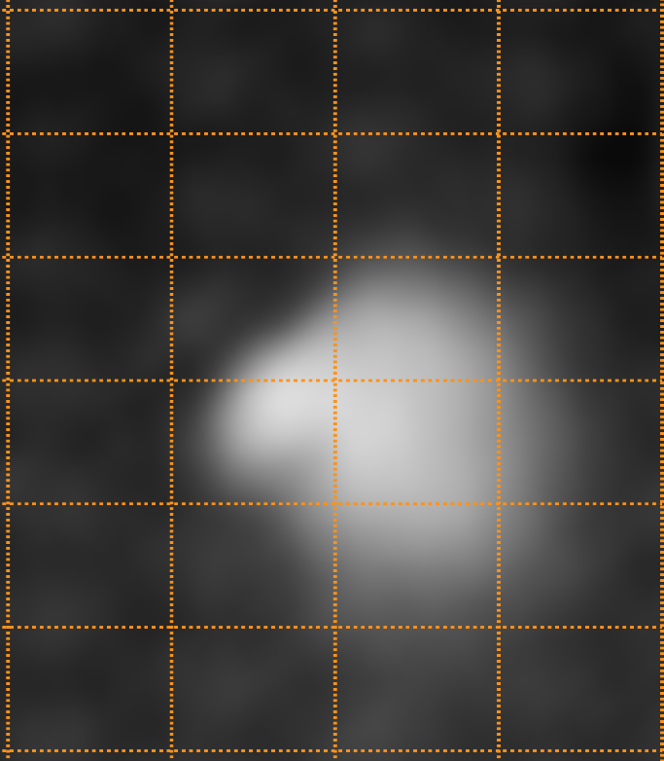
Figure 2
Maybe line-scans could be a nice addition
A
B
C
A ) STM image of V₂0₅ particle before water dose. The as-deposited feature extents across two O_{br}–rows (vertical orange guide-lines) and is centered on-top of one O_{br}– site (between two horizontal guide-lines) B) STM image of V₂0₅ particle during water dose. This feature has a two major features on-top of fully coordinated Ti-6f sites, together with two minor features on the adjacent row. This feature has a mirror plan going through its horizontal center. C) STM image of V₂0₅ particle after water dose. This feature has a lesser bright feature broad feature (extending 2 sites) on top of the fully coordinated Ti-6f site, in one row and bright feature on-top of the Ti-5f site.

